Slide 1

SPEECH TO EMOTION RECOGNITION
Presented by:
Vanshika Mittal
Yesh Lohchab

Slide 2
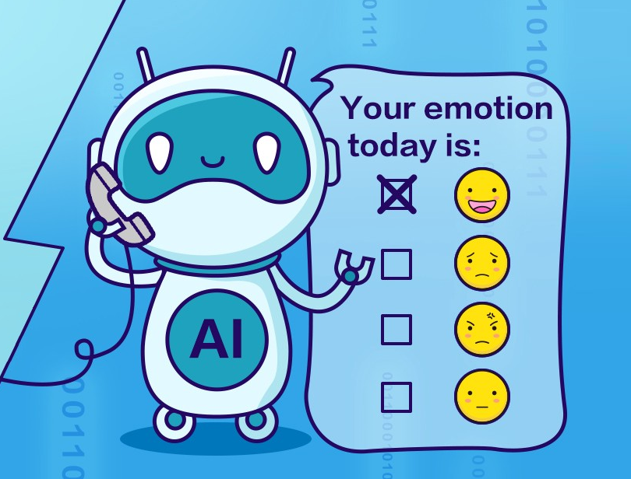
Need of emotion detection?
1
2
With more people interacting with Virtual Personal Assistants (VPAs) like Siri, Alexa, and Google Assistant, there is a need to improve these systems to recognize users' emotions. While current VPAs excel at understanding commands, they lack the ability to respond to the user’s mood, which could enhance natural interaction.
3
4
5
6
7
8
9

Slide 3
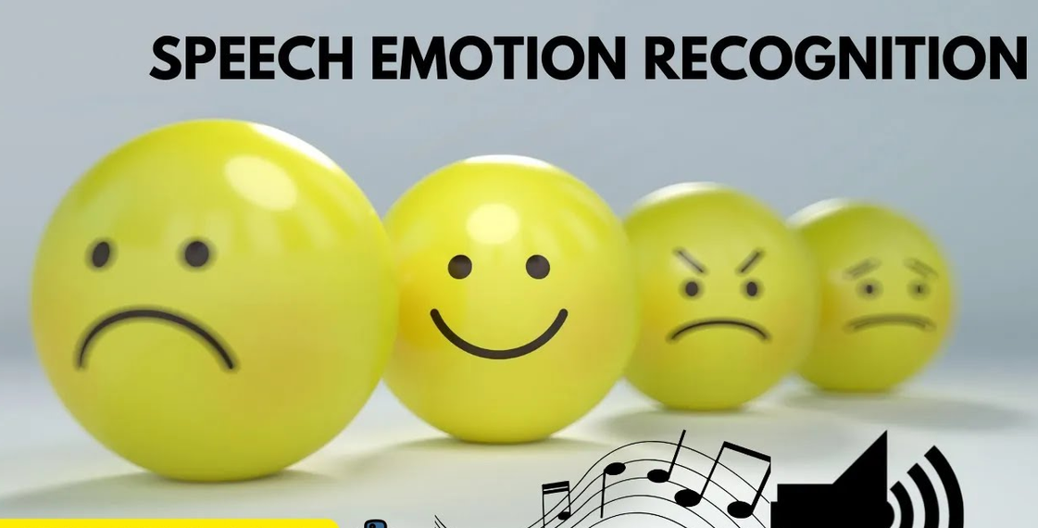
Speech Features for Emotion Recognition
1
2
3
4
Speech conveys both linguistic (words) and paralinguistic (tone, pitch, emotion) information.
5
6
Emotions can be represented as:
Continuous: Psychological dimensions like activation (energy) and valence (positive or negative emotion).
Discrete: Specific categories, e.g., happy, sad, angry.
7
8
9

Slide 4
1
Data Sets Used
2
3
Datasets used in this project
* Crowd-sourced Emotional Mutimodal Actors Dataset (Crema-D)
* Ryerson Audio-Visual Database of Emotional Speech and Song (Ravdess)
* Surrey Audio-Visual Expressed Emotion (Savee)
* Toronto emotional speech set (Tess)
4
5
6
7
8
9

Slide 5
Model and Features
1
Feature Selection in Audio Emotion Detection
Categories of Audio Features:
Time-Domain Features: Simple, easily extracted metrics (e.g., short-term energy, zero-crossing rate) for initial analysis.
Frequency-Domain Features: Reveal deeper patterns and are more effective for emotion detection (e.g., spectrograms, MFCCs).
2
3
4
5
6
Key Feature chosen:
Mel-Spectrograms:
Represents time vs. frequency on a Mel scale.
Log transformation aligns with human perception, enabling clearer emotion patterns.
7
8
9
Log-Mel Spectrograms represented as images are fed into CNNs or RNNs for emotion classification.

Slide 6
Audio Augmentation Techniques
1
Purpose: Enhance data variability to improve model robustness
2
Augmentation Methods:
Noise Addition: Adds random noise (adjustable by noise_factor) for realistic background sounds.
Reverberation: Simulates room acoustics by convolving with an impulse response (IR) signal, if provided.
Time Shift: Shifts audio along the time axis, controlled by max_shift_ms.
Volume Perturbation: Randomly adjusts audio volume by a specified dB_change.
3
4
5
6
7
8
Random Selection Process:
Randomly applies one augmentation to each sample, promoting diverse training data.
9

Slide 7
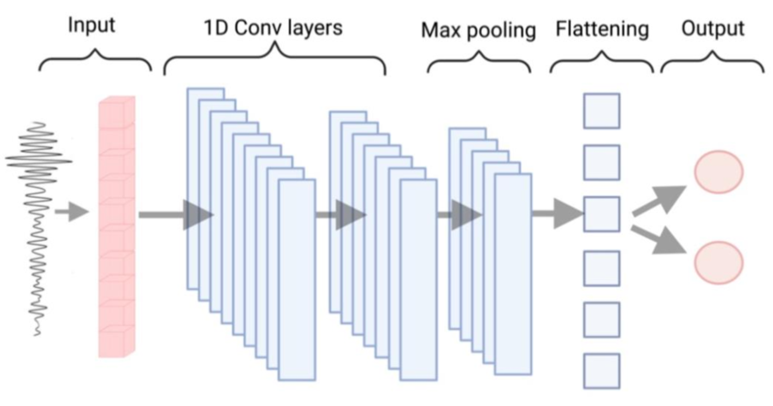
Model Description:
1
In our model, we are using either ResNet50 or EfficientNetB7 as the backbone.
ResNet50: Known for efficient feature extraction and deeper architecture.
EfficientNetB7: Balances accuracy and efficiency with a smaller model size and strong performance.
Base Architecture:
Pretrained Weights: Both models use weights pre-trained on ImageNet, which helps improve performance by leveraging pre-learned features.
Input Shape: Reshaped to (128, 154, 3) to fit the speech spectrogram data.
Additional Layers:
Global Average Pooling: Reduces the feature map to a single vector per channel.
Dense Layer: A 128-unit dense layer with ReLU activation for feature refinement.
Output Layer: 8-class softmax layer, classifying into specific emotions (e.g., happy, sad, angry).
2
3
4
5
6
7
8
Visual representation of 1D CNN with Max pooling layer

Slide 8
Challenges
1
2
1) We tried to augment the data by reverbration, and in order to add a reverberation effect to an audio signal in Python, you can use convolution with an impulse response (IR) signal. An IR signal represents the reverberation characteristics of a particular space, such as a room or hall, which we convolve with the audio to create the effect
3
4
5
6
so we need an Impulse Response Signal to add Reverberation effect
7
2) CNN models like Resnet50 and EfficientNet which we are using for processing image of mel-spectrogram are pre-trained on RGB images. These models expect 3-channel input because they are designed for standard image formats. Therefore, we had to convert the mel spectrogram into an RGB format, so that we can leverage these models without significant architecture changes.
8
9

Slide 9
Challenges
1
2
3) since the size of the dataset is very large, creating spectrogram for each signal and then storing each spec plot will take up a lot of time and space, therefore, Spectrograms are not stored individually, Instead paths are stored, the spectrograms are formed for each evaluation (on spot) thus reducing the storage requirements and speeding the training and testing process significantly
3
4
5
7
7
8
4) For Hyperparameter tuning, we used 2-Fold, 12-Fit Randomized Search CV instead of 18- FIt Grid Search CV that enabled efficient and comprehensive hyperparameter exploration, saving time without significantly compromising performance evaluation.
8
9

Slide 10
1
2
3
4
Thank you
5
6
7
8
9

